Slide 1

MARTE Tutorial
An OMG standard:
UML profile to develop Real-Time and Embedded systems
Overview, NFP / VSL, GCM

Slide 2

Context of This Work
The present courseware has been elaborated in the context of the MODELPLEX European IST FP6 project (http://www.modelplex.org/).
Co-funded by the European Commission, the MODELPLEX project involves 21 partners from 8 different countries.
MODELPLEX aims at defining and developing a coherent infrastructure specifically for the application of MDE to the development and subsequent management of complex systems within a variety of industrial domains.
To achieve the goal of large-scale adoption of MDE, MODELPLEX promotes the idea of a collaborative development of courseware dedicated to this domain.
The MDE courseware provided here with the status of open-source software is produced under the EPL 1.0 license.
Modelplex MARTE Tutorial – January 2009

Slide 3
Agenda
Part 1
  Marte Overview
Part 2
  A component model for RT/E
Part 3
  Non-functional properties modeling
Modelplex MARTE Tutorial – January 2009

Slide 4
UML Profiling Basics
Profile:
  Lightweight Extension / Specialization of the UML metamodel
    For particular application domains
  Stereotypes
    Extension / Specialization of existing metaclasses
    Contains a set of “tagged values” (i.e. domain specific properties)
  Constraints
    On the usage of stereotypes
    On the usage of constructs provided by the source metamodel
  Notation options (i.e. icons, figures)
Modelplex MARTE Tutorial – January 2009
« profile »
C++Profile
MyModel
Uml2::Kernel
Operation
«apply»
MyClass
myOpA()
myOpB()
« cppVirtual » myOpC()
« stereotype »
cppVirtual

Slide 5
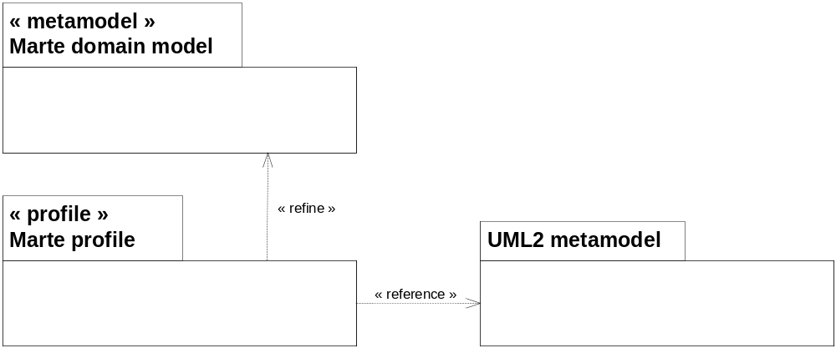
Design Pattern Adopted for the MARTE Profile
Stage 1 → Description of MARTE domain models (DV)
  Purpose: Formal description of the concepts required for MARTE
  Techniques: Meta-modeling
Stage 2 → Mapping of MARTE domain models towards UML2: UML Representation (UR)
  Purpose: MARTE domain models design as a UML2 extensions
  Techniques: UML2 profile
Modelplex MARTE Tutorial – January 2009

Slide 6



How to read this tutorial
Within next slides, we may shown models at different levels of abstraction. We will clarify each level through following pictograms
  For Domain View level
  For UML Profile View Level
  For User Model View Level
Modelplex MARTE Tutorial – January 2009

Slide 7
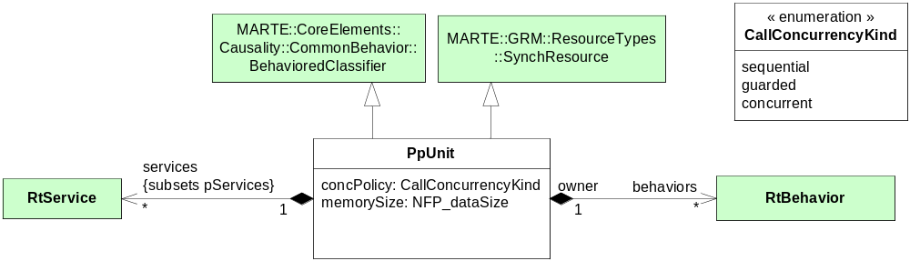
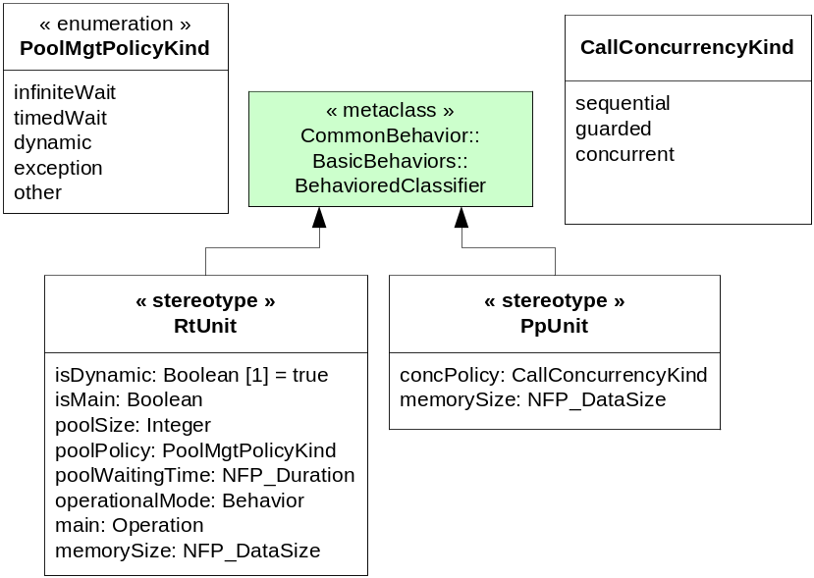
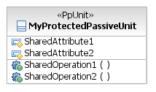
Example: Domain model → Profile → Usage
Modelplex MARTE Tutorial – January 2009

Slide 8
Relationships with other OMG Standards
Relationships with generic OMG standards
  Profile the UML2 superstructure meta-model
  Replace UML Profile for SPT (Scheduling, Performance and Time)
  Use OCL2 (Object Constraints Language)
Relationships with RT&E specific OMG standards
  Existing standards
    The UML profile for Modeling QoS and FT Characteristics and Mechanisms
      Addressed through MARTE NFP package (in a way detailed in the NFP presentation)
    The UML profile for SoC (System On Chip)
      More specific than MARTE purpose
    The Real-Time CORBA profile
      Real-Time CORBA based architecture can be annotated for analysis with Marte
    The UML profile for Systems Engineering (SysML)
      Specialization of SysML allocation concepts and reuse of flow-related concepts
      Ongoing discussion to include VSL in next SysML version
      Overlap of team members
Modelplex MARTE Tutorial – January 2009

Slide 9
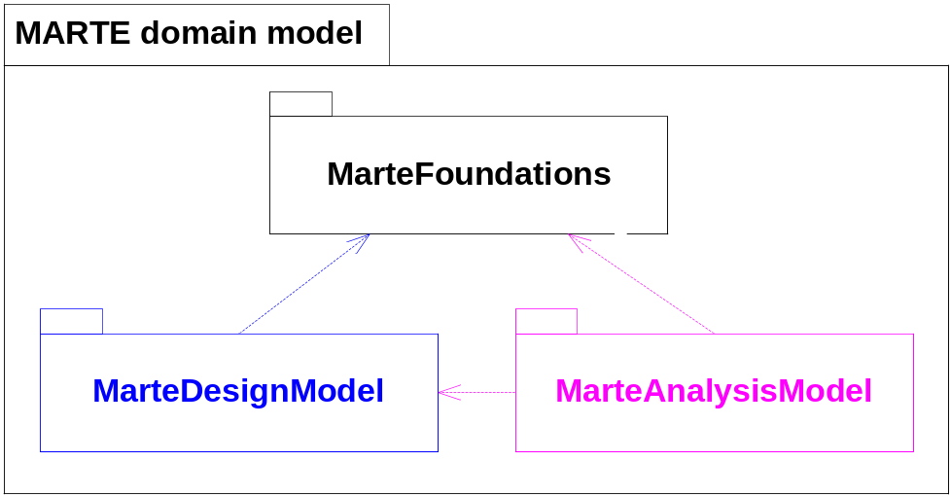
MARTE Overview
Modelplex MARTE Tutorial – January 2009
Foundations for RT/E systems modeling and analysis:
➔ CoreElements
➔ NFPs
Time
Generic resource modeling
Generic component modeling
Allocation
Specialization of foundations for annotating model for analysis purpose:
➔ Generic quantitative analysis
➔ Schedulability analysis
➔ Performance analysis
Specialization of MARTE foundations for modeling purpose (specification, design, …):
➔ RTE model of computation and communication
Software resource modeling
Hardware resource modeling
Extracted from S.Gerard (ECRTS07)

Slide 10
MARTE Frontiers and Challenges
MARTE define the language constructs only!
  Common patterns, base building blocks, standard NFP annotations
  Generic constraints that do not force specific execution models, analysis techniques or implementation technologies
It does not cover methodologies aspects:
  Interface-Based Design, Design Space Exploration
  Means to manage refinement of NFP measurement models
  Concrete processes to storage, bind, and display NFP context models
  Mapping to transform MoCCs into analysis models
Modelplex MARTE Tutorial – January 2009
MARTE is to the RTES domain as UML to the System &
Software domain: a family of large and open
specification formalisms!

Slide 11
Agenda
Part 1
  Marte Overview
Part 2
  A component model for RT/E
Part 3
  Non-functional properties modeling
Modelplex MARTE Tutorial – January 2009

Slide 12
Component-based paradigms in the RTE domain
Component architectures are increasingly used in RTE execution platforms
  Need for manageable and reusable pieces of software
  Key examples: Lightweight-CCM, SCA, Autosar
Concept of component also used to structure System / Software engineering processes
  Entities under analysis/design broken down into a series of components
  Applicable at different stages of the process
  Different kind: active vs. passive (e.g., UML active classes)
  Examples of related languages: SysML, AADL
Modelplex MARTE Tutorial – January 2009
There is a need to provide modeling constructs to support these concepts at different levels of abstraction

Slide 13
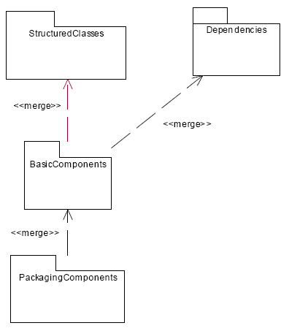
What is a component in UML?
UML distinguishes the notions of structured class and component
Modelplex MARTE Tutorial – January 2009
  The kernel of the language defines Class and Interface
  StructuredClasses defines Port and Connector and provide the ability to describe a Class as an assembly of parts
  Basic and PackagingComponent define the notion of component realization and adds packaging capabilities
In any case, no support for flow-oriented communications
Notes:
StructuredClasses => Basis for UML composite structure diagrams
Components => Software components (e.g. EJB, CORBA) along with their related artifacts
Depending on the context, will make use of StructuredClasses, BasicComponents,
PackgingComponents… and will call it “a component” !

Slide 14
General Component Model
Introduced to cope with various component-based models
  SysML, Spirit, AADL, Lightweight-CCM, EAST-ADL2, Autosar
Does not imply any specific model of computation
Relies mainly on UML structured classes, on top of which a support for SysML blocks has been added
  Atomic and non-atomic flow ports
  Flow properties and flow specifications
But also providing a support for Lightweight-CCM, AADL and EAST-ADL2, Spirit and Autosar
Modelplex MARTE Tutorial – January 2009
Notes:
The general component model introduced in this specification proposes mainly refinements to the
UML structured classes. This model provides a common denominator among various component
models, which in principle do not target exclusively the real-time and embedded domain. The purpose
is to provide in MARTE a model as general as possible, that is not tied to specific execution
semantics, on which real-time characteristics can be applied later on. The MARTE general component
model relies mainly on UML structured classes, on top of which a support SysML blocks has been
added. Providing a support for Lightweight-CCM, AADL and EAST-ADL2 have also influenced the
definition of some refinements of the MARTE General Component Model.

Slide 15
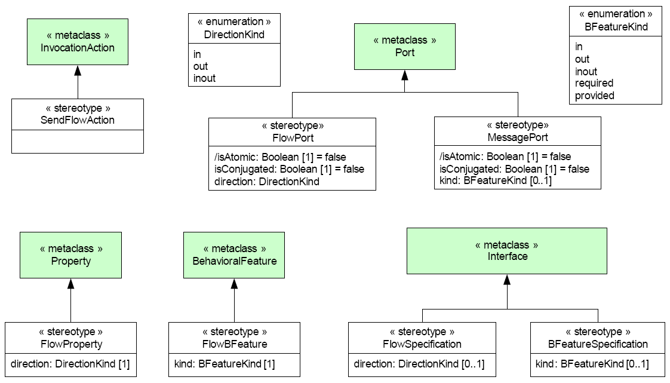
The MARTE GCM subprofile
Modelplex MARTE Tutorial – January 2009

Slide 16
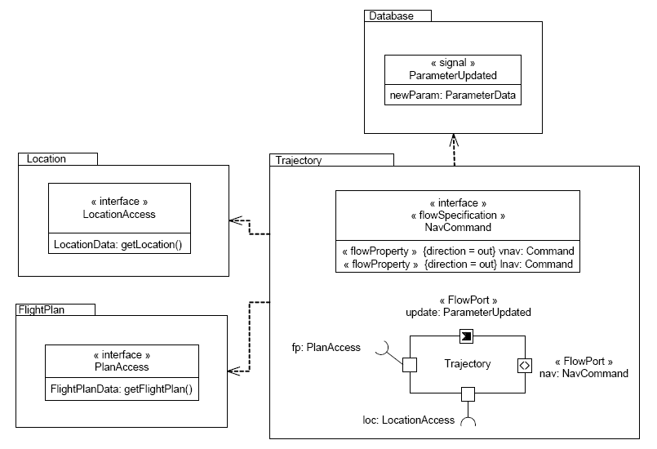
Example of component definition
Atomic flow port typed by a Classifier
Modelplex MARTE Tutorial – January 2009
Complex flow port typed by a flow specification
Standard UML port typed by a class that uses the LocationAccess interface
Notes:
Figure 11.18 illustrates a Trajectory component used in a Flight Management System inspired from an
avionics textbook. This component computes a trajectory and generates continuous navigation
commands to other equipment. Trajectory depends on three components, defined in related
packages, to perform its tasks: FlightPlan, Location and Database.
Revised submission of the UML profile for MARTE p. 139
Trajectory makes use of flight plan data, as well as the current plane location to perform computations.
It explicitly calls the getLocation and getFlightPlan required services, to access these data when
needed. These services are defined in the LocationAccess and FlightPlanAccess interfaces, bound to
two dedicated message ports.
Trajectory also makes use of performance and fuel consummation parameters stored in its cache. It
happens that a pilot changes these parameters, initially stored in the database, when the FMS is in
operation. If so, the Database component notifies Trajectory that new parameters need to be taken
into account. This information is pushed through an atomic flow port to the Trajectory component. The
icon indicates that the direction of the Trajectory flow port is “in”. The flow port is typed by a
ParameterUpdated signal that contains new parameter data.
When computations are completed, Trajectory generates navigation commands as a data flow
specified by the NavCommand flow specification. The data flow is transmitted to external equipment
through a dedicated flow port. The icon indicates that the port is typed by a flow specification and
therefore it is not atomic.

Slide 17
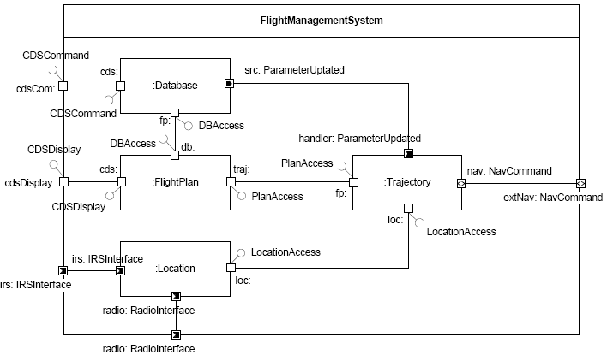
Example of component usage
Outgoing atomic flow port
Modelplex MARTE Tutorial – January 2009
Incoming atomic flow port
UML delegation connector used with a non-atomic flow port
UML delegation connector used with an atomic flow port
Notes:
Delegation connector,
Assembly connectors
Figure 11.19 illustrates the internal structure of the simple FMS. It shows how the Trajectory
component, along with FlightPlan, Location and Database, is used as a part of the
FlightMangementSystem composite structure. One can distinguish boundary ports, owned by
FlightManagementSystem and defined at the component boundaries. These ports relay incoming data
inside a component (e.g., cdsCom, cdsDisplay, irs, radio) or outgoing data to other connected
components (e.g., extNav). The other ports indicated in the composite structure relate to component
parts (e.g., fp, loc, update, nav, owned by the :Trajectory part). These ports are used to tie parts
together using connectors and define a component assembly. Within a component assembly,
connected ports need to define compatible types and directions. Message ports need to be typed by a
common interface (e.g., PlanAccess), a left-hand port providing this interface (e.g., traj) and a righthand
port requiring this interface (e.g., fp). Flow ports need to be typed by a common flow element or
flow-specification (e.g., ParameterUpdated), with opposite directions on the left-hand and right-hand
ports (e.g. ,src and handler).
A boundary port can be connected to a port owned by a part in order to relay a service invocation or a
data flow to the component assembly (e.g., cdsDisplay and cds). In that case, port directions are
relayed as well

Slide 18
Agenda
Part 1
  Marte Overview
Part 2
  A component model for RT/E
Part 3
  Non-functional properties modeling
Modelplex MARTE Tutorial – January 2009

Slide 19
NFP tutorial Goals
To give a “MARTE NFPs” background, yes, but also…
To know its main design rationales
To know its modeling capabilities/alternatives and to learn how and when to use them
Modelplex MARTE Tutorial – January 2009
Notes:
This talk deals with two main aspects in real-time system verification: 1) building analyzable UML models, and 2) model integration for multiple verification techniques.
We will show how MARTE specializes UML to specify analyzable embedded systems, what are its frontiers and limitations, and what is still needed to reach the abovementioned objectives at industrial level.

Slide 20
Non-Functional Properties
An information of a modeled system, or system
part, which is not related to its functional purpose
(e.g., latencies, memory size, power consumption)
Modelplex MARTE Tutorial – January 2009
Information used to:
  Static V&V: performance prediction, resource usage evaluation, …
  Dynamic configuration: resource management, mode changes, …
Should include design process information:
  How information was obtained (estimations, measurement,…)?
  How information was calculated (derived parameters, refinement)?
  How accurate information is?

Slide 21
Previous Work
Main known approaches:
  NFR Framework: an approach to evaluate different quality goals and their interference.
  CQML (Aagedal): language for expressing qualities in contract-aware components (no semantic link to execution model)
  QCCS: it enhances CQML by providing refinement capabilities and a link to a basic execution model (operation, event identification)
OMG approaches:
  SPT Profile: Tag Value Language (TVL) for expressing mathematical, logical and basic time expressions.
  QoS Profile (based on CQML): QoS value qualifiers, required an offered constraints (assume/guarantee component interfaces), catalog approach.
Modelplex MARTE Tutorial – January 2009

Slide 22
The MARTE’s NFP Modeling Framework
(NFPs Profile + VSL)
A set of extensions to specify semantically rich
non-functional annotations
Modelplex MARTE Tutorial – January 2009
NFPs sub-profile → based on the QoS Profile:
  Measurements: magnitude + unit (e.g., energy, data size, duration)
  Qualifiers: Value source, statistical measure, value precision,…
Value Specification Language (VSL) → based on TVL and OCL:
  Mathematical expressions (arithmetic, logical, …)
  Time expressions (delays, periods, trigger conditions,…)
  Variables: placeholders for unknown analysis parameters.

Slide 23
NFP Framework:
Basic Description
Modelplex MARTE Tutorial – January 2009

Slide 24
The NFPs Profile
Three main stereotypes:
  Nfp, Nfptype, NfpConstraint, Unit
A predefined library of Units and NfpTypes:
  Power, Frequency, DataSize, DataTxRate, Duration, BoundDuration,…
  A set of generic qualifier for these NFP Types
  A placeholder for “expressions” in addition to the actual “value”.
Three mechanism to annotate NFP values:
  Tagged Values
  InstanceSpecification Slots
  Constraints
Modelplex MARTE Tutorial – January 2009

Slide 25
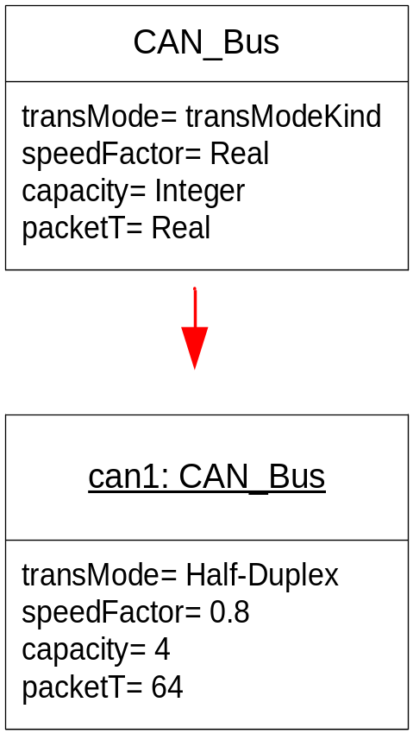
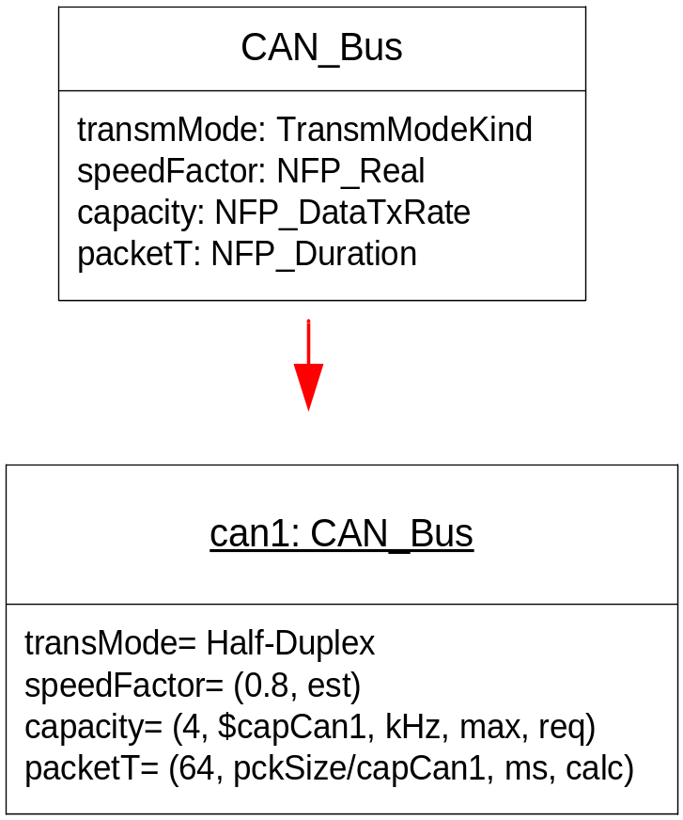
Extending UML Expressiveness for NFPs
CAN Bus with Pure UML
CAN Bus with MARTE’s NFP
Modelplex MARTE Tutorial – January 2009

Slide 26
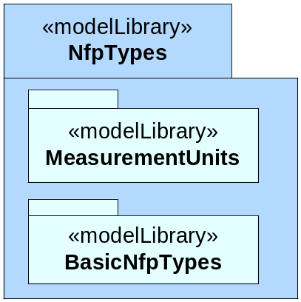
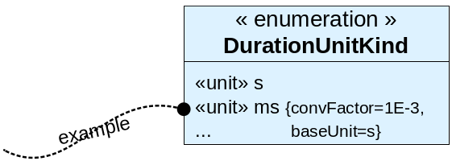
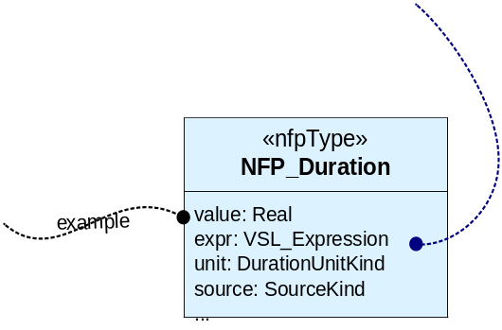
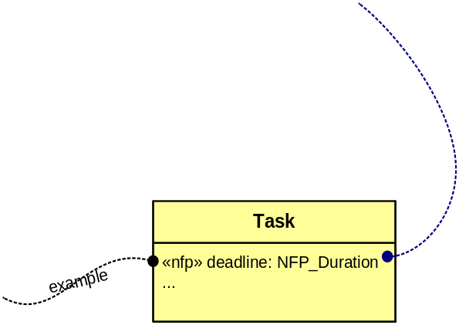
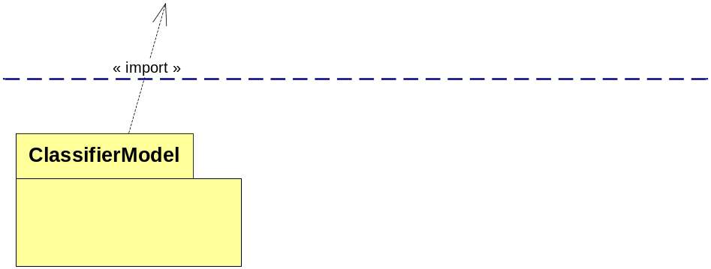
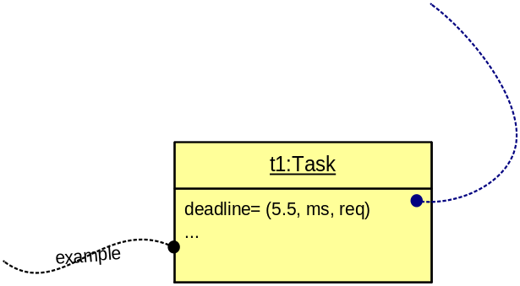
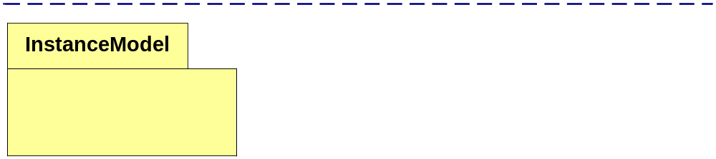
Basic NFP Annotation Mechanism (Slots)
1) Declare NFP types
Modelplex MARTE Tutorial – January 2009
- Define measurement units and conversion parameters
- Define NFP types with qualifiers
2) Declare NFPs in user models
- Define classifiers and their
attributes using NFP types
- Such attributes are tagged as «nfp»
3) Specify NFP values
- Instantiate classifiers and specify their slot values using VSL

Slide 27
The Value Specification Language
Formally defined (unlike TVL)
  Provide a metamodel based on the UML one (DataTypes & ValueSpecifications)
    A subset of additional metaclasses are implemented as Stereotypes (DataTypes)
  Expression metaclasses are extended as an orthogonal language.
    MARTE proposes a grammar implementation
    It may be implemented by a separated metamodel (e.g. based on Ecore)
A extended system of data types:
  Composite types: Tuples, Choice, Collection types
  Subtypes: bounded subtype
A extended language for expressions:
  Primitives, Composites, Expression&Variables, Time Expressions.
Three mechanism to annotate NFP values:
  Tagged Values, InstanceSpecification Slots, and Constraints
Modelplex MARTE Tutorial – January 2009

Slide 28
Basic Textual Expressions in VSL
Extended Primitive Values
Extended Composite Values
Extended Expressions
Modelplex MARTE Tutorial – January 2009
Value Spec. | Examples
Real Number | 1.2E-3 //scientific notation
DateTime | #12/01/06 12:00:00# //calendar date time
Collection | {1, 2, 88, 5, 2} //sequence, bag, ordered set.. {{1,2,3}, {3,2}} //collection of collections
Tuple and choice | (value=2.0, unit= ms) //duration tuple value periodic(period=2.0, jitter=3.3) //arrival pattern
Interval | [1..251[ //upper opened interval between integers [$A1..$A2] //interval between variables
Variable declaration & Call | io$var1 //input/output variable declaration var1 //variable call expression.
Arithmetic Operation Call | +(5.0,var1) //”add” operation on Real datatypes 5.0+var1 //infix operator notation
Conditional Expression | ((var1<6.0)?(10^6):1) //if true return 10 exp 6,else 1

Slide 29
Design Rationales & Further Usage
Modelplex MARTE Tutorial – January 2009

Slide 30
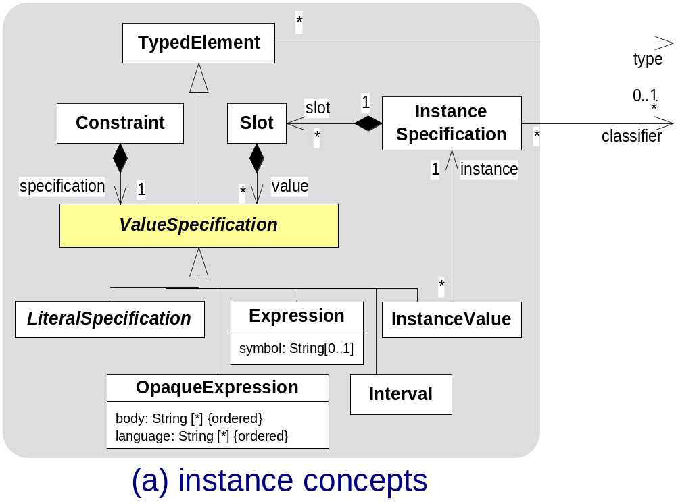
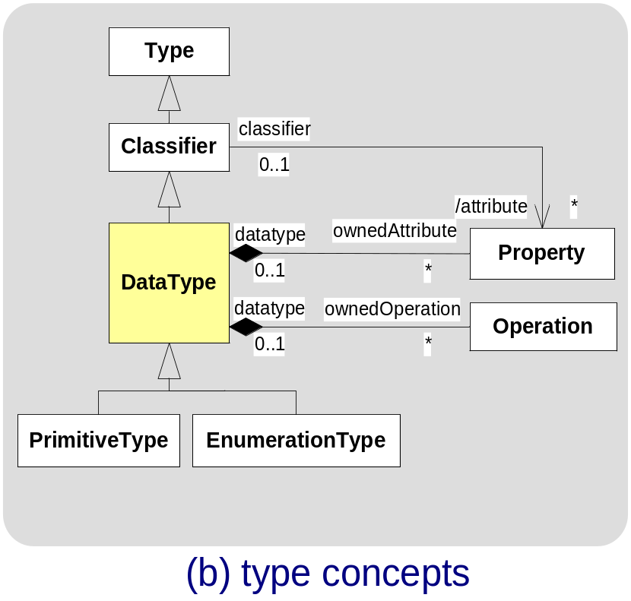
UML-Related Concepts
Modelplex MARTE Tutorial – January 2009

Slide 31
Some Design Choices
Why not the QoS Profile?
  Too complex annotation mechanism
    Two stages to annotate model & models borrowed by InstanceSpecifications
  But mainly… political reasons ;-)
  Result → NFP stereotypes replace QoS ones
Why not Stereotypes to extend UML expressions?
  As we intend to annotate NFP values in Tagged Values, we don’t want to stereotype information within TaggedValues
  We don’t want to confuse users by mixing M1 and M2 levels
  Result → Qualifiers in NfpTypes & a new textual language: VSL
Modelplex MARTE Tutorial – January 2009

Slide 32
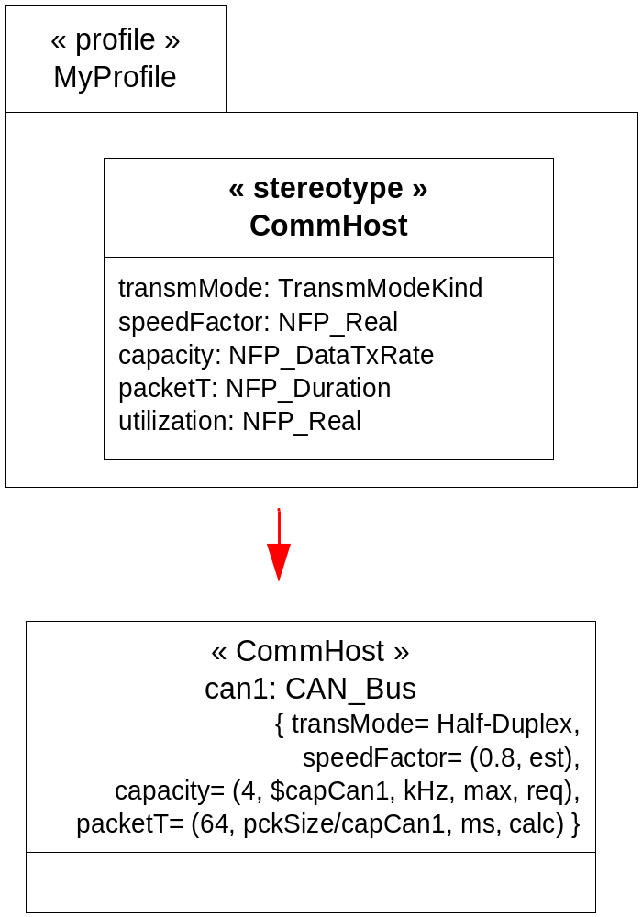
Annotating NFPs in Tagged Values: Ex.
CAN Bus annotated with Stereotypes
Modelplex MARTE Tutorial – January 2009

Slide 33

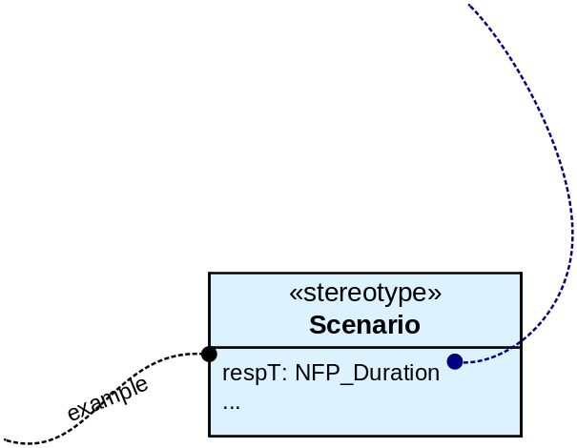
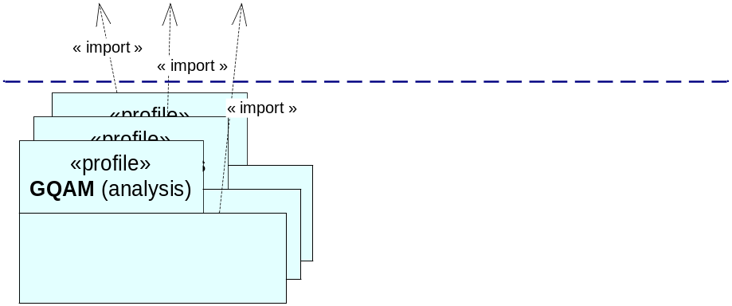
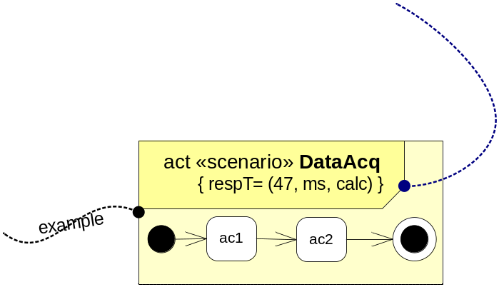
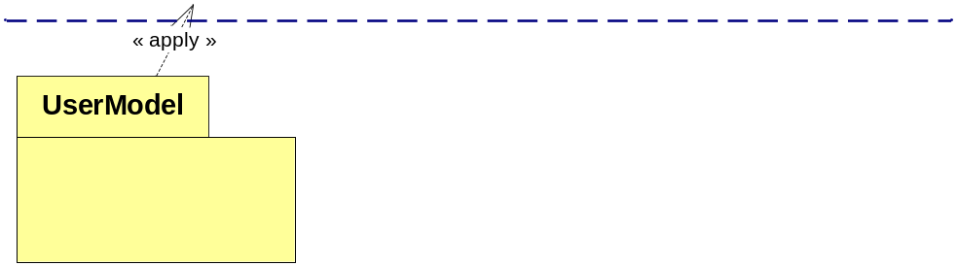
Annotating NFPs in Tagged Values
1) Declare NFP types
Modelplex MARTE Tutorial – January 2009
- Define measurement units and conversion parameters
- Define NFP types with qualifiers
2) Define NFP-like extensions
MARTE pre-defined
- Define stereotypes and their attributes using NFP types
3) Specify NFP values
- Apply stereotypes and specify their tag values using VSL

Slide 34
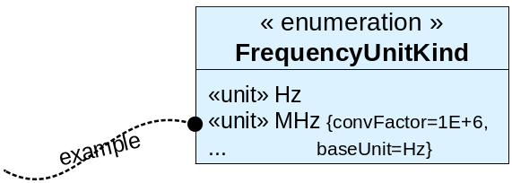
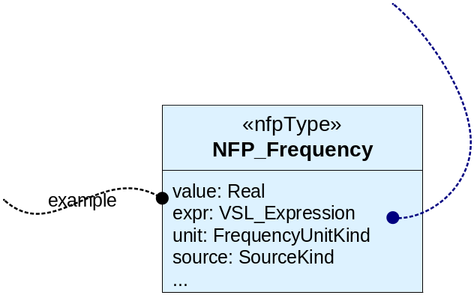
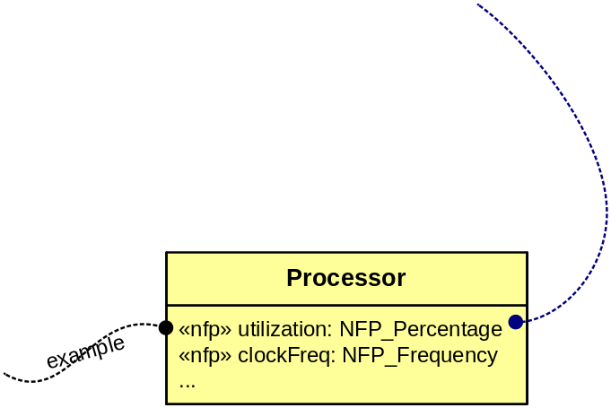
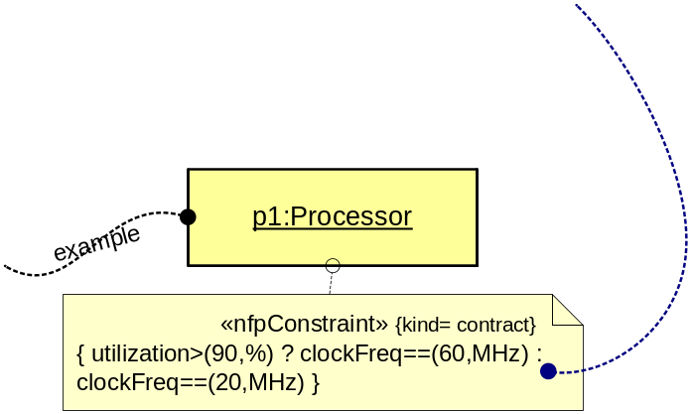
Annotating NFPs in Constraints
1) Declare NFP types
- Define measurement units and conversion parameters
- Define NFP types with qualifiers
Modelplex MARTE Tutorial – January 2009
2) Declare NFPs
-Define classifiers and their attributes using NFP types
3) Specify NFP values
Create Constraints to define assertions on NFP values using VSL
«nfpConstraint» is a required, offered, or contract constraint of NFPs

Slide 35
Some Design Choices (2)
Why not OCL instead of VSL?
  Too hard to learn for end users
  No time expressions
  Result → VSL reuse OCL syntax, but the metamodel is closer to UML one
VSL take into account the ISO Standard: General Purpose DataTypes
  It allows to map the VSL syntax to standard programming languages (e.g., C, Pascal)
Modelplex MARTE Tutorial – January 2009

Slide 36

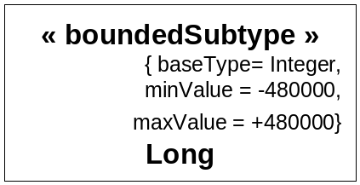
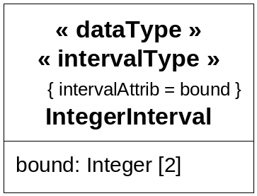
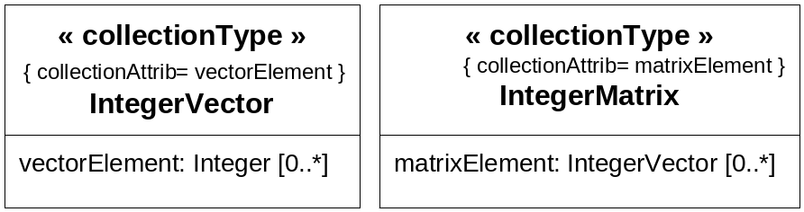
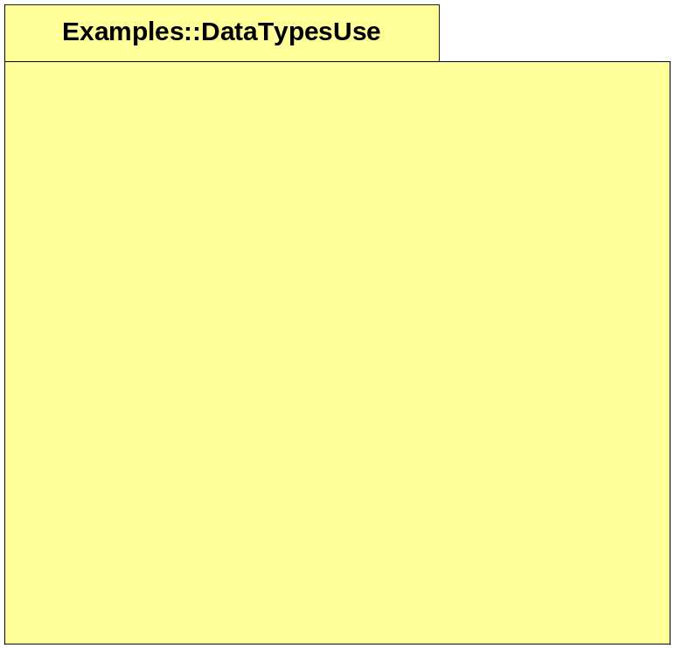
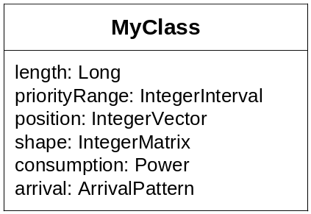
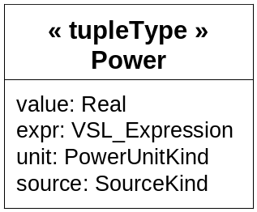
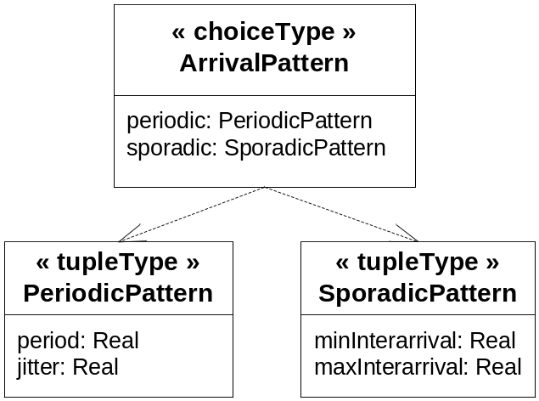
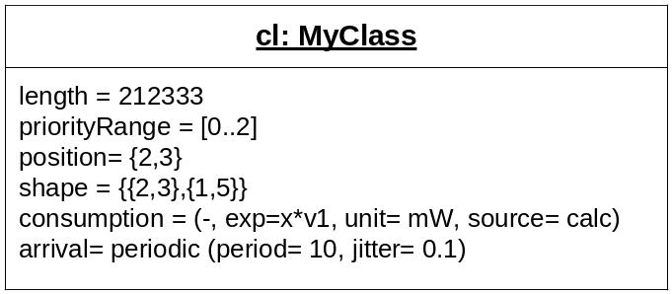
VSL Extended Data Types
BoundedSubtype
IntervalType
CollectionType
TupleType
ChoiceType
Modelplex MARTE Tutorial – January 2009
Declaration example…
Specification example…

Slide 37
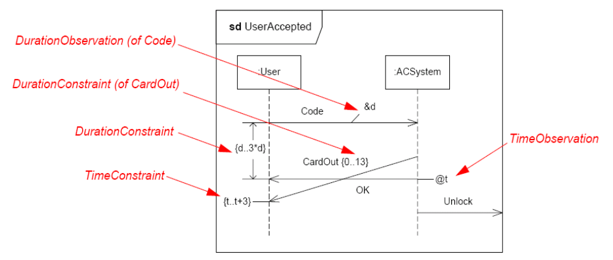
UML (native) Observation Concept
An time observation is a reference to a time instant during an execution.
Modelplex MARTE Tutorial – January 2009
An duration observation is a reference to a time interval during an execution.
Specification example in Sequence diagrams…

Slide 38
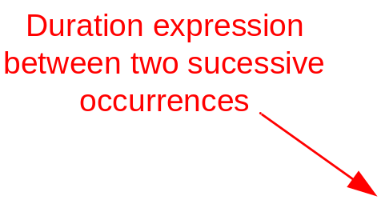
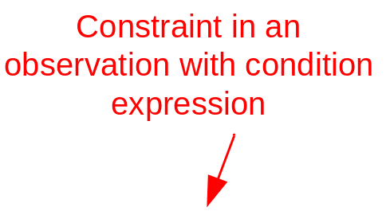
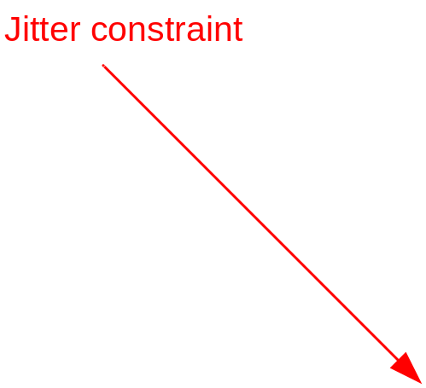
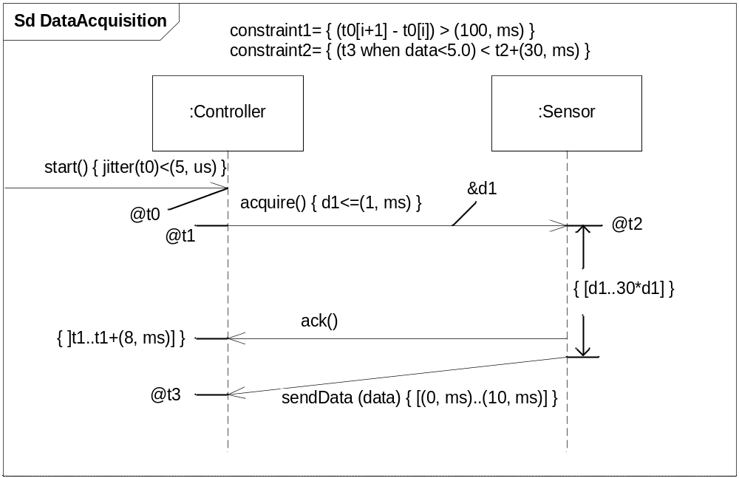
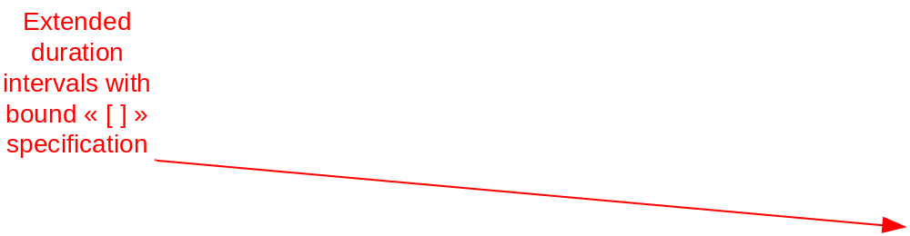

Time Expressions with VSL
Specification example in Sequence diagrams…
Modelplex MARTE Tutorial – January 2009
Duration Observation

Slide 39
Summary of NFP Modeling Framework
Usability vs. Flexibility:
  Three annotation mechanisms: Stereotypes, Properties and Constraints
  Stereotypes: predefined NFPs (e.g., end-to-end latency, processor utilization)
  Properties & Constraints: user-specific NFPs (but still unambiguously interpreted)
Synthesis of best modeling practices…
  Reuse OCL constructs: grammar for values and expressions
  Formally defined by abstract (metamodel) and concrete (grammar) syntaxes→ Can be implemented as non-UML based language
  VSL supports time expressions (occurrence index, jitters,...)
Modelplex MARTE Tutorial – January 2009

